Slide 2
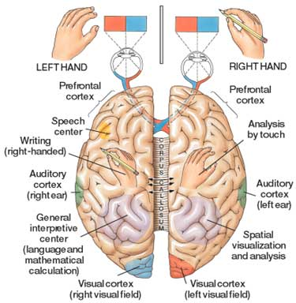
FUNCTIONAL DIFFERENCES
HOW DO THEY DIFFER ?
MALES
FEMALES
Learning & performing tasks
Abstract & Task oriented
Focus on exact issues & disregard impertinent info.
Better math skills
Better coordination
Better sense of direction
Risk taking
Focus more on visual senses
Juggling different tasks
Social thinking & Interactions
More empathic & comprehensive in thinking
Perceive pain intensely
More expressive
Better memory
Use multiple senses

Slide 3
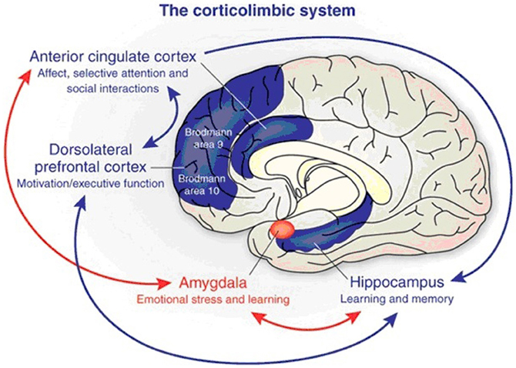

Slide 4

WHY FEMALES ARE MORE CAPABLE OF MULTI TASKING?

Slide 5
Grey v/s White Matter
Grey matter- Men have approximately 6.5 times more grey matter than women.
White matter- Women have about 10 times more white matter than men.
Women have more of the white matter responsible for communication.
So, women have greater ability to do multitask.

Slide 6

Why men have a better sense of direction

Slide 7
AMYGDALA
Influenced by hormones.
Processes fear, triggers aggression and action.
Stimulates competitiveness.
Larger in men.
Fires fear signals.

Slide 8
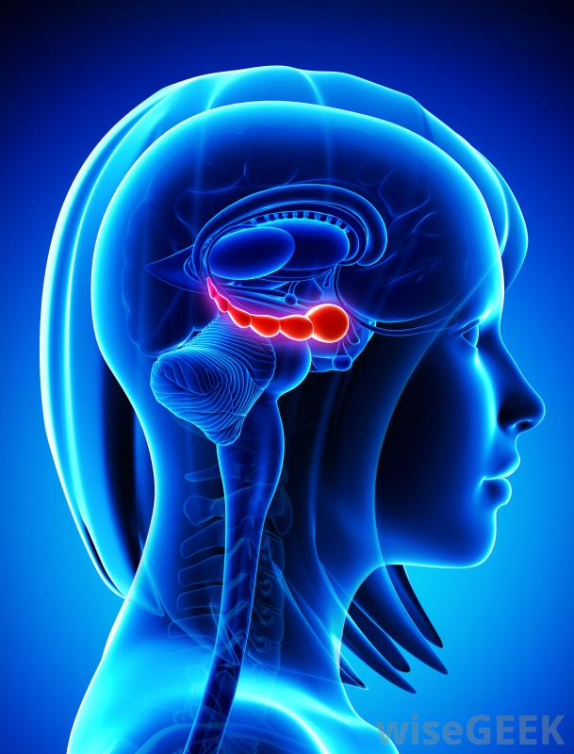
WHY FEMALES ARE BETTER AT EXPRESSING EMOTIONS
AND REMEMBERING DETAILS?

Slide 9
HIPPOCAMPUS
Center for learning, memory & emotions.
Larger & more active in the female brain.
Women have 11% more neurons than men for language and hearing.
Men use only the right side of their brains.
Women uses both sides of their brains.
Hence better at expressing emotions and memorising.

Slide 10

Why men are risk taking while women are cautious?

Slide 11


ANTERIOR CINGULATE CORTEX
Rational decision making center of the brain.
weighs options.
larger in women.
labeled as the "worrywart" center for women.
Research says anxiety is four times more common in women than men.
Men influenced by risk-taking testosterone.
The corpus callosum is thicker in women .

Slide 12
Women use both sides of their brains
For visual and verbal processing
To respond to emotional experiences
men use the right side for spatial skills
left for verbal skills

Slide 13

Why Females Distinguish Colors Better While Men Excel At Tracking Fast Moving Objects ?

Slide 14
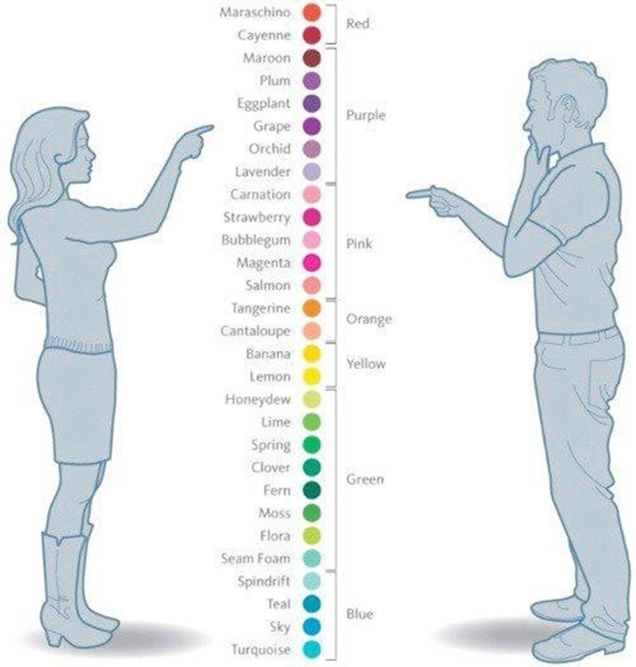
Men require a slightly longer wavelength than females to experience the same hue.
Men are less adept at distinguishing the shades.
can detect quick-changing details from afar
Males are born with 25% more neurons in this brain region than women.
Female better adapted at recognizing static objects like wild berries.

